Slide 1
Topological methods for graph analysis
Yusu Wang
The Ohio State University

Slide 2
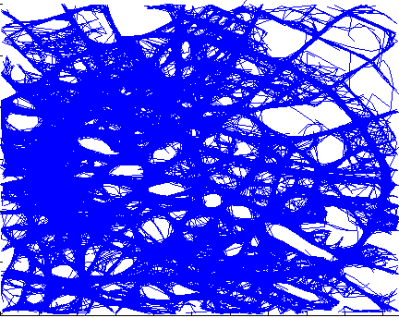
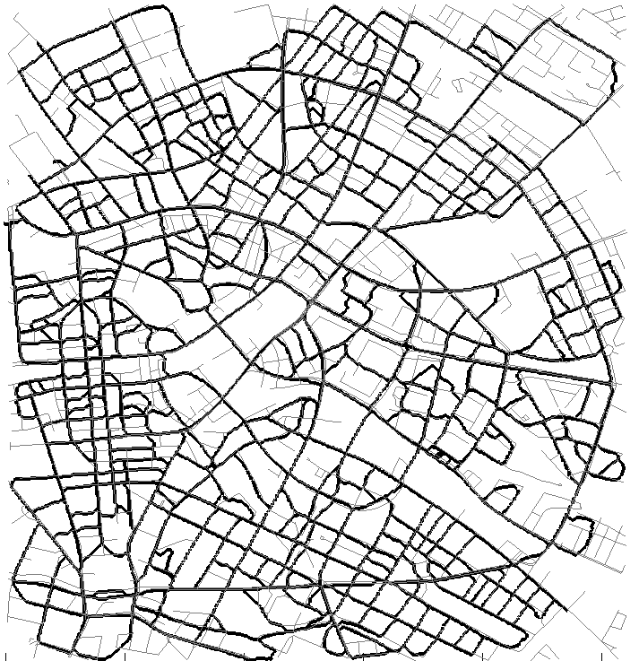
Introduction
Graphs naturally occur in many applications
  Hidden space: graph-like structures
  Simple, non-linear structure behind data
Input: GPS trajectories
Goal: Road network

Slide 3
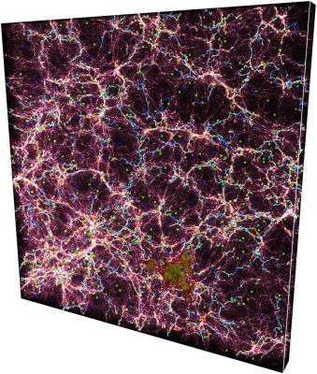
Introduction
Graphs naturally occur in many applications
  Hidden space: graph-like structures
  Simple, non-linear structure behind data
http://www2.iap.fr/users/sousbie/web/html/indexd41d.html

Slide 4
This Talk
Some recent examples of analyzing / understanding graphs using topological ideas / algorithms

Slide 5
This Talk
Some examples of analyzing / understanding (metric) graphs using topological ideas / algorithms
Metric graph matching
  via persistence distortion
Geometric graph reconstruction
  via discrete Morse theory
Understanding metric graphs
  of persistence signature induced by the intrinsic Cech filtration

Slide 6
This Talk
Some examples of analyzing / understanding (metric) graphs using topological ideas / algorithms
Metric graph matching
  via persistence distortion
Geometric graph reconstruction
  via discrete Morse theory
Understanding metric graphs
  of persistence signature induced by the intrinsic Cech filtration

Slide 7
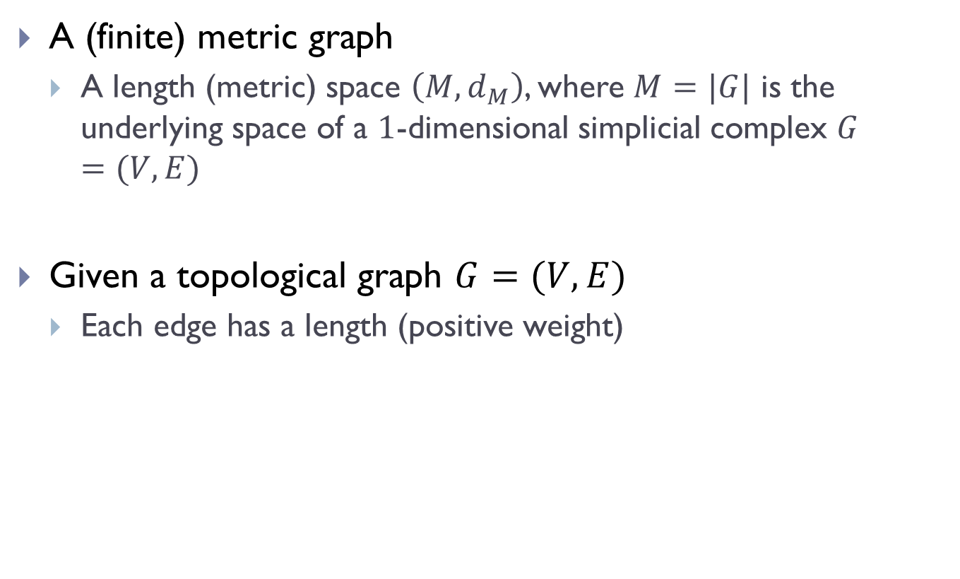
Metric Graphs
A (finite) metric graph
  A length (metric) space $\left(M, d_{M}\right)$, where $M=|G|$ is the underlying space of a $1$-dimensional simplicial complex $G=(V,E)$
Given a topological graph $G=(V,E)$
  Each edge has a length (positive weight)

Slide 8
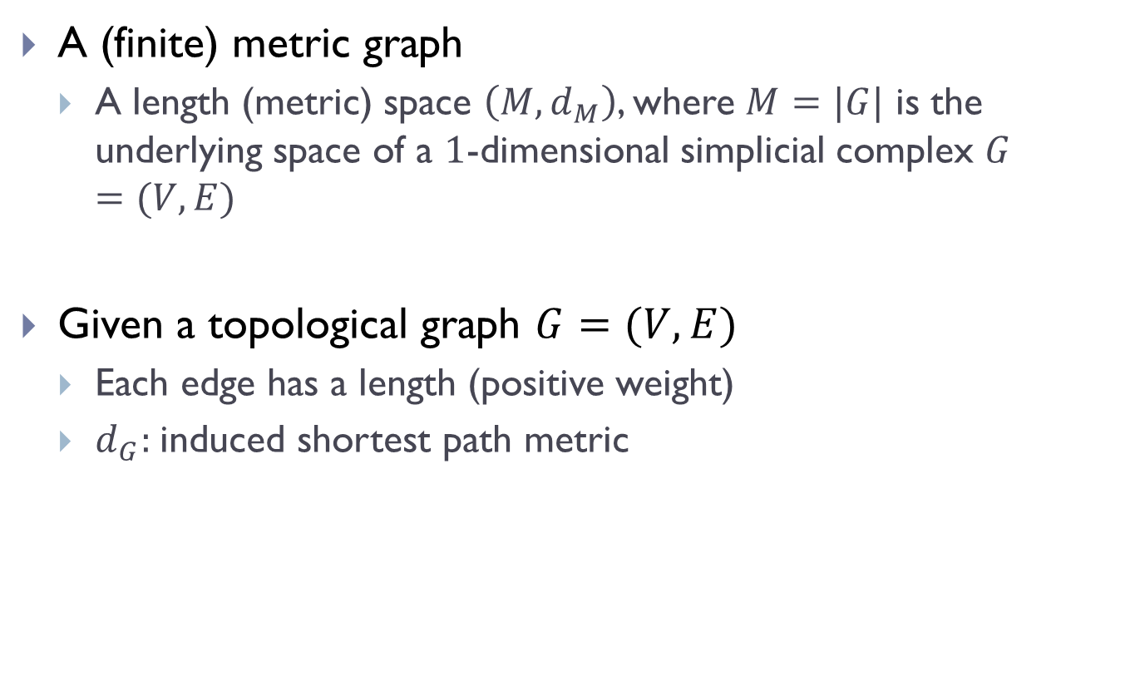
Metric Graphs
A (finite) metric graph
  A length (metric) space $\left(M, d_{M}\right)$, where $M=|G|$ is the underlying space of a $1$-dimensional simplicial complex $G=(V,E)$
Given a topological graph $G=(V,E)$
  Each edge has a length (positive weight)
  $d_{G}:$induced shortest path metric

Slide 9
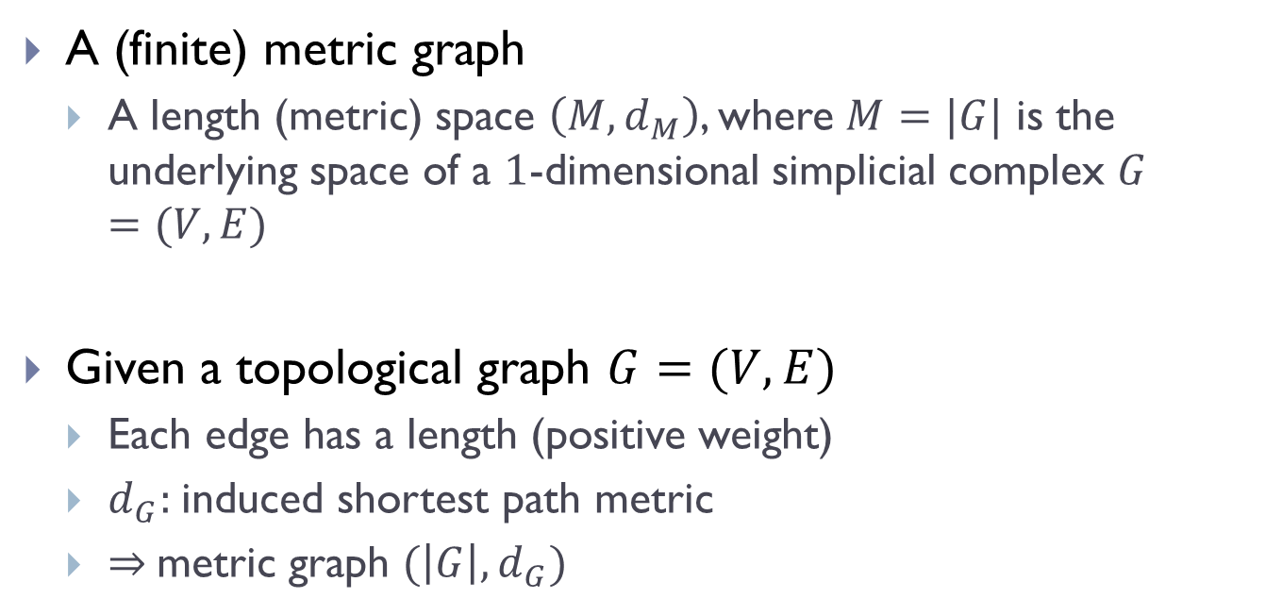
Metric Graphs
A (finite) metric graph
  A length (metric) space $\left(M, d_{M}\right)$, where $M=|G|$ is the underlying space of a $1$-dimensional simplicial complex $G=(V,E)$
Given a topological graph $G=(V,E)$
  Each edge has a length (positive weight)
  $d_{G}:$induced shortest path metric
  $⇒$metric graph $(\left|G\right|, d_{G})$
Metric graph $(G, d_{G})$ or $\left(G=(V,E),d_{G}\right)$

Slide 10
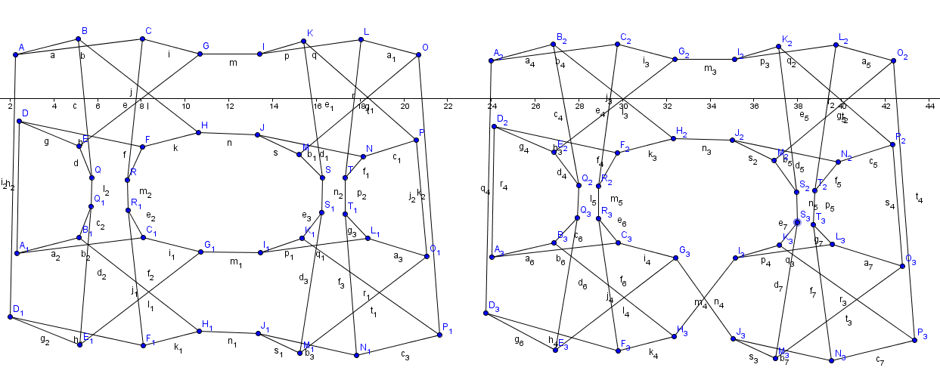
Graph Matching
Exact graph matching: graph isomorphism testing
  Polynomial time algorithms exist for special cases
    Planar graphs, bounded valence graphs
  In general
    Quasipolynomial time ([Babai 2017, arXiv 2016])
  Heuristic approaches
    E.g, Nauty

Slide 11
Inexact Graph Matching
Distance between two input (weighted) graphs
  Graph edit distance
  Integer quadratic programing (IQP) –based
  …
Optimization problems formulated often NP-hard,
and various heuristic approaches developed in practice to improve efficiency

Slide 12


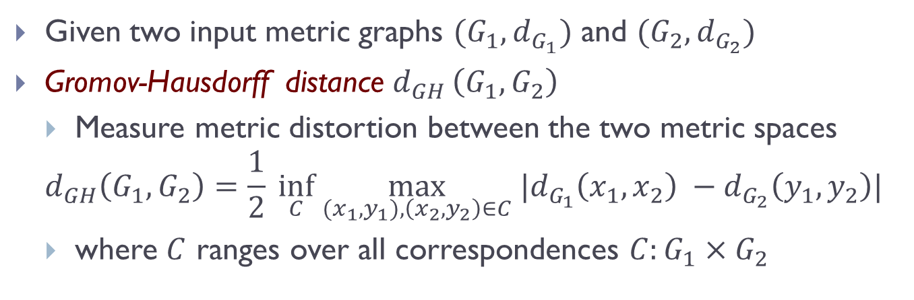




Metric Graphs View
  Given two input metric graphs $(G_{1},d_{G_{1}})$ and $(G_{2},d_{G_{2}})$
  Gromov-Hausdorff distance $d_{GH }\left(G_{1},G_{2}\right)$
  Measure metric distortion between the two metric spaces
  $$d_{GH}\left(G_{1},G_{2}\right)=\frac{1}{2} \inf_{C} \max_{{(x}_{1},y_{1}), \left(x_{2},y_{2}\right)∈C} |d_{G_{1}}\left(x_{1},x_{2}\right) −d_{G_{2}}\left(y_{1},y_{2}\right)|$$
  where $C$ ranges over all correspondences $C:G_{1}×G_{2}$
$$G_{1}$$
$$G_{2}$$
$$y_{2}$$
$$x_{2}$$
$$x_{1}$$
$$y_{1}$$

Slide 13
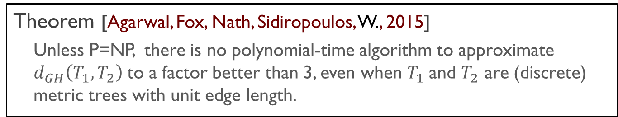
Metric Graphs View
  Given two input metric graphs $(G_{1},d_{G_{1}})$ and $(G_{2},d_{G_{2}})$
  Gromov-Hausdorff distance $d_{GH }\left(G_{1},G_{2}\right)$
  Measure metric distortion between the two metric spaces
  $$d_{GH}\left(G_{1},G_{2}\right)=\frac{1}{2} \inf_{C} \max_{{(x}_{1},y_{1}), \left(x_{2},y_{2}\right)∈C} |d_{G_{1}}\left(x_{1},x_{2}\right) −d_{G_{2}}\left(y_{1},y_{2}\right)|$$
  where $C$ ranges over all correspondences $C:G_{1}×G_{2}$
Theorem [Agarwal, Fox, Nath, Sidiropoulos, W., 2015]
  Unless P=NP, there is no polynomial-time algorithm to approximate $d_{GH}\left(T_{1}, T_{2}\right)$to a factor better than 3, even when $T_{1}$and $T_{2}$ are (discrete) metric trees with unit edge length.

Slide 14
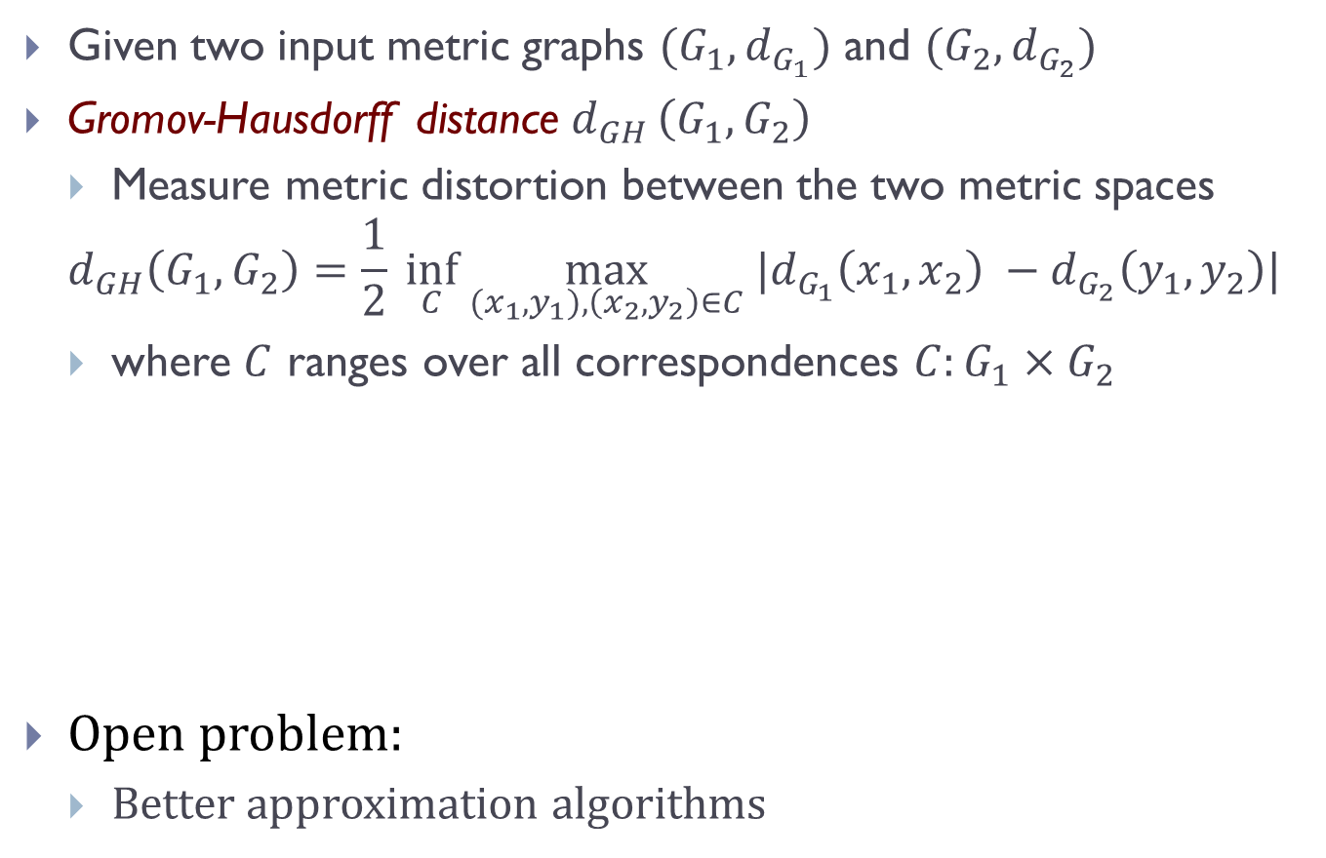
Metric Graphs View
  Given two input metric graphs $(G_{1},d_{G_{1}})$ and $(G_{2},d_{G_{2}})$
  Gromov-Hausdorff distance $d_{GH }\left(G_{1},G_{2}\right)$
  Measure metric distortion between the two metric spaces
  $$d_{GH}\left(G_{1},G_{2}\right)=\frac{1}{2} \inf_{C} \max_{{(x}_{1},y_{1}), \left(x_{2},y_{2}\right)∈C} |d_{G_{1}}\left(x_{1},x_{2}\right) −d_{G_{2}}\left(y_{1},y_{2}\right)|$$
  where $C$ ranges over all correspondences $C:G_{1}×G_{2}$
Open problem:
  Better approximation algorithms
Theorem [Agarwal, Fox, Nath, Sidiropoulos, W., 2015]
  Unless P=NP, there is no polynomial-time algorithm to approximate $d_{GH}\left(T_{1}, T_{2}\right)$to a factor better than 3, even when $T_{1}$and $T_{2}$ are (discrete) metric trees with unit edge length.

Slide 15
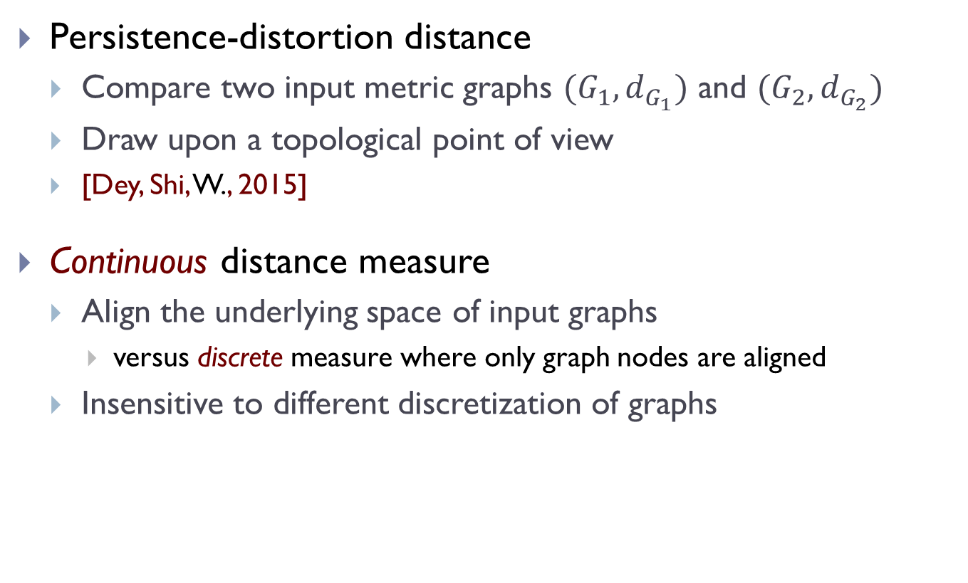
Persistence-distortion
Persistence-distortion distance
  Compare two input metric graphs $(G_{1},d_{G_{1}})$ and $(G_{2},d_{G_{2}})$
  Draw upon a topological point of view
  [Dey, Shi, W., 2015]
Continuous distance measure
  Align the underlying space of input graphs
    versus discrete measure where only graph nodes are aligned
  Insensitive to different discretization of graphs

Slide 16
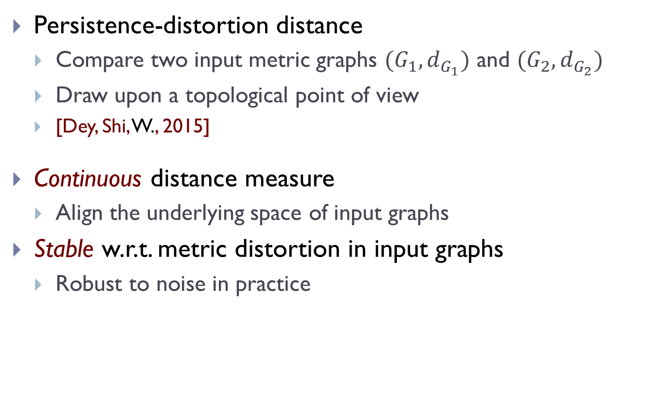
Persistence-distortion
Persistence-distortion distance
  Compare two input metric graphs $(G_{1},d_{G_{1}})$ and $(G_{2},d_{G_{2}})$
  Draw upon a topological point of view
  [Dey, Shi, W., 2015]
Continuous distance measure
  Align the underlying space of input graphs
Stable w.r.t. metric distortion in input graphs
  Robust to noise in practice

Slide 17
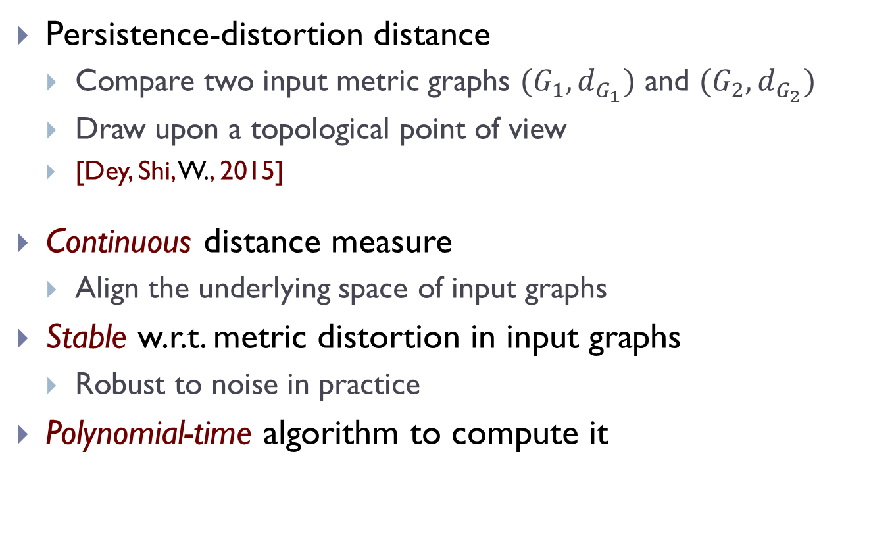
Persistence-distortion
Persistence-distortion distance
  Compare two input metric graphs $(G_{1},d_{G_{1}})$ and $(G_{2},d_{G_{2}})$
  Draw upon a topological point of view
  [Dey, Shi, W., 2015]
Continuous distance measure
  Align the underlying space of input graphs
Stable w.r.t. metric distortion in input graphs
  Robust to noise in practice
Polynomial-time algorithm to compute it

Slide 18

Distance function to a basepoint
For any $s∈\left|G\right|,$consider $f:\left|G\right|→R$defined as
  $f\left(x\right)↦d_{G}\left(s, x\right)$ , for any $x∈\left|G\right|$
Consider the 0th persistence diagram $P_{s}= Dg_{0} f$
  Induced by super-level set filtration of $f$
Extended or zigzag persistence can be used to capture also all loop information

Slide 19
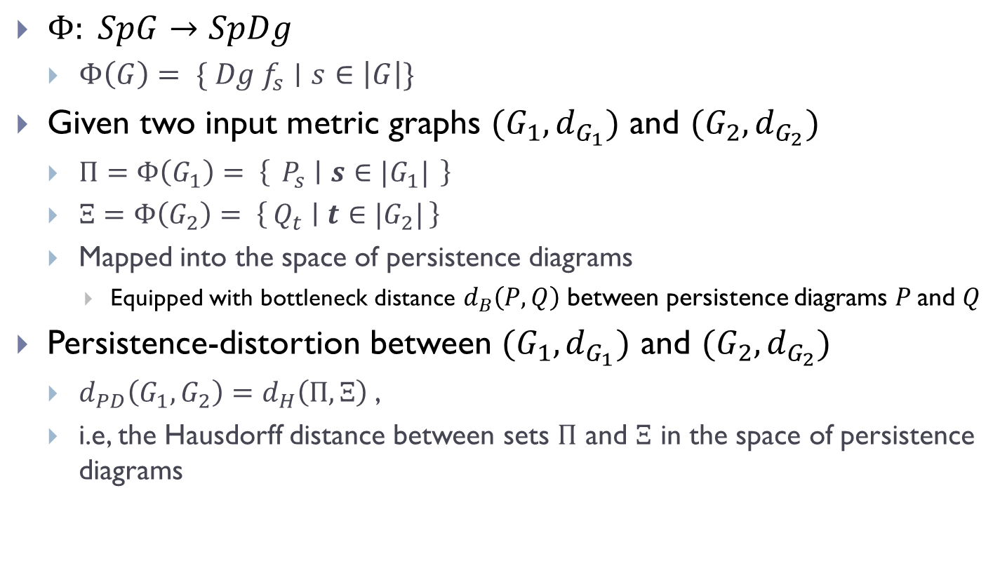
Persistence-distortion Distance
$Φ: SpG→SpDg$
  $Φ\left(G\right)= \{ {Dg f}_{s}∣s∈\left|G\right|\}$
Given two input metric graphs $(G_{1},d_{G_{1}})$ and $(G_{2},d_{G_{2}})$
  $Π=Φ\left(G_{1}\right)= \left\{ P_{s} ∣ s∈{|G}_{1}| \right\}$
  $Ξ=Φ\left(G_{2}\right)= \left\{Q_{t} ∣ t∈{|G}_{2}|\right\}$
  Mapped into the space of persistence diagrams
    Equipped with bottleneck distance $d_{B}\left(P, Q\right)$ between persistence diagrams $P$and $Q$
Persistence-distortion between $(G_{1},d_{G_{1}})$ and $(G_{2},d_{G_{2}})$
  $d_{PD}\left(G_{1},G_{2}\right)=d_{H}\left(Π, Ξ\right)$,
  i.e, the Hausdorff distance between sets $Π$ and $Ξ$ in the space of persistence diagrams

Slide 20
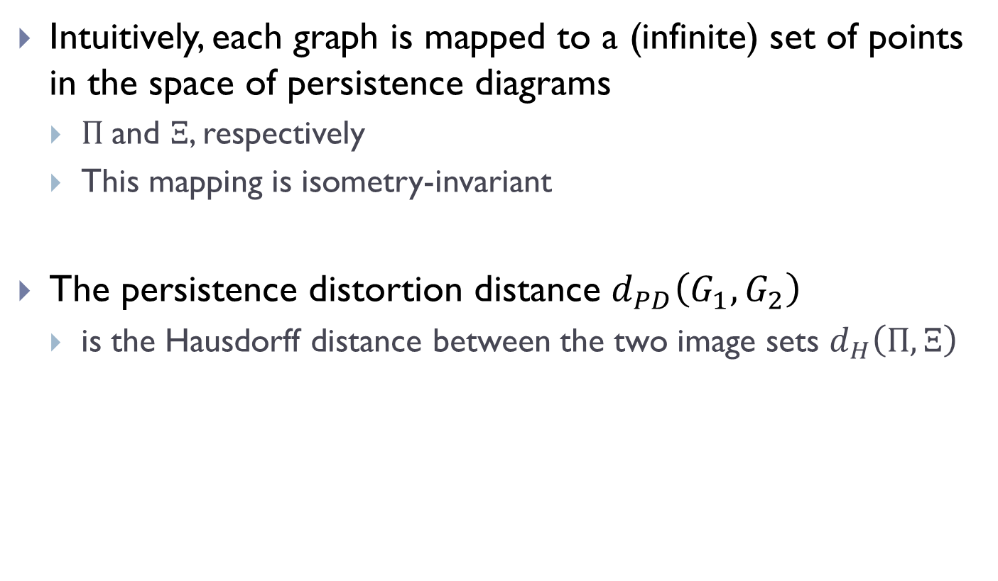
Intuitively, each graph is mapped to a (infinite) set of points in the space of persistence diagrams
  $Π$and $Ξ$, respectively
  This mapping is isometry-invariant
The persistence distortion distance $d_{PD}\left(G_{1},G_{2}\right)$
  is the Hausdorff distance between the two image sets $d_{H}\left(Π, Ξ\right)$

Slide 21
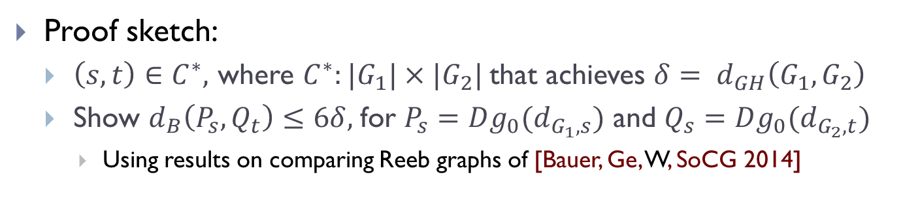
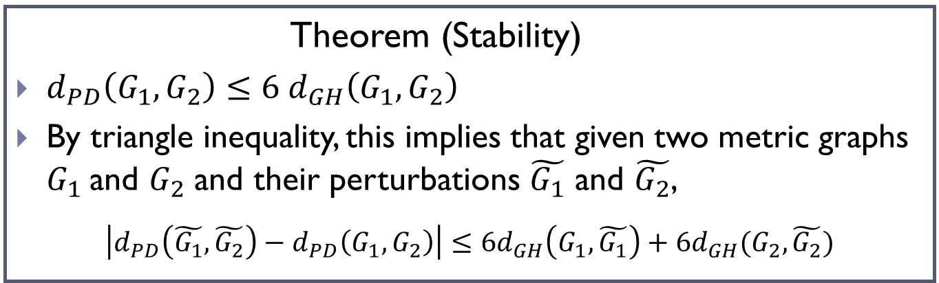
Stability
Theorem (Stability)
$d_{PD}\left(G_{1},G_{2}\right)≤6 d_{GH}\left(G_{1}, G_{2}\right)$
By triangle inequality, this implies that given two metric graphs $G_{1}$and $G_{2}$ and their perturbations $\tilde{G_{1}}$ and $\tilde{G_{2}}$,
$$\left|d_{PD}\left(\tilde{G_{1}},\tilde{G_{2}}\right)−d_{PD}\left(G_{1},G_{2}\right)\right|≤6d_{GH}\left(G_{1},\tilde{G_{1}}\right)+6d_{GH}(G_{2},\tilde{G_{2}})$$
Proof sketch:
  $\left(s, t\right)∈C^{∗},$ where $C^{∗}:{|G}_{1}|×{|G}_{2}|$that achieves ${δ= d}_{GH}\left(G_{1}, G_{2}\right)$
  Show $d_{B}\left(P_{s}, Q_{t}\right)≤6δ,$for $P_{s}={Dg_{0}(d}_{G_{1},s})$ and $Q_{s}={Dg_{0}(d}_{G_{2},t})$
    Using results on comparing Reeb graphs of [Bauer, Ge, W, SoCG 2014]

Slide 22
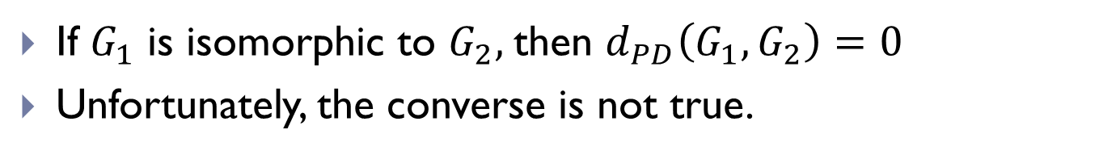
Graph Isomorphism Testing?
If $G_{1}$ is isomorphic to $G_{2},$then $d_{PD}\left(G_{1},G_{2}\right)=0$
Unfortunately, the converse is not true.

Slide 23
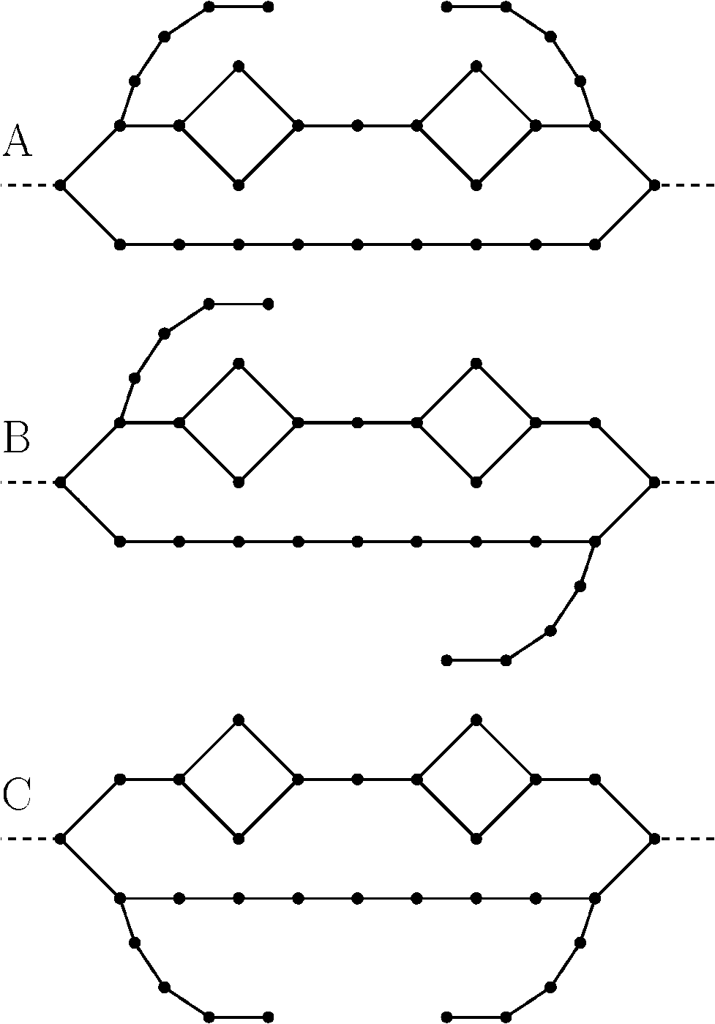
Example

Slide 24
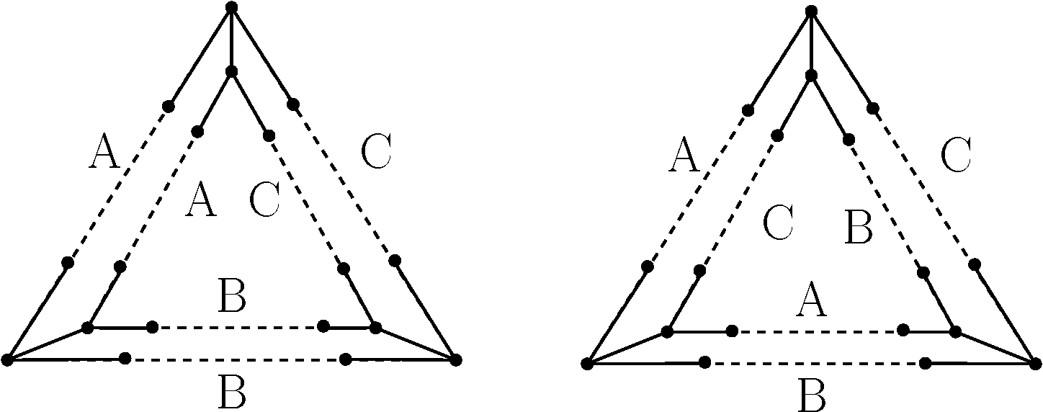


Example
$$G_{1}$$
$$G_{2}$$

Slide 25
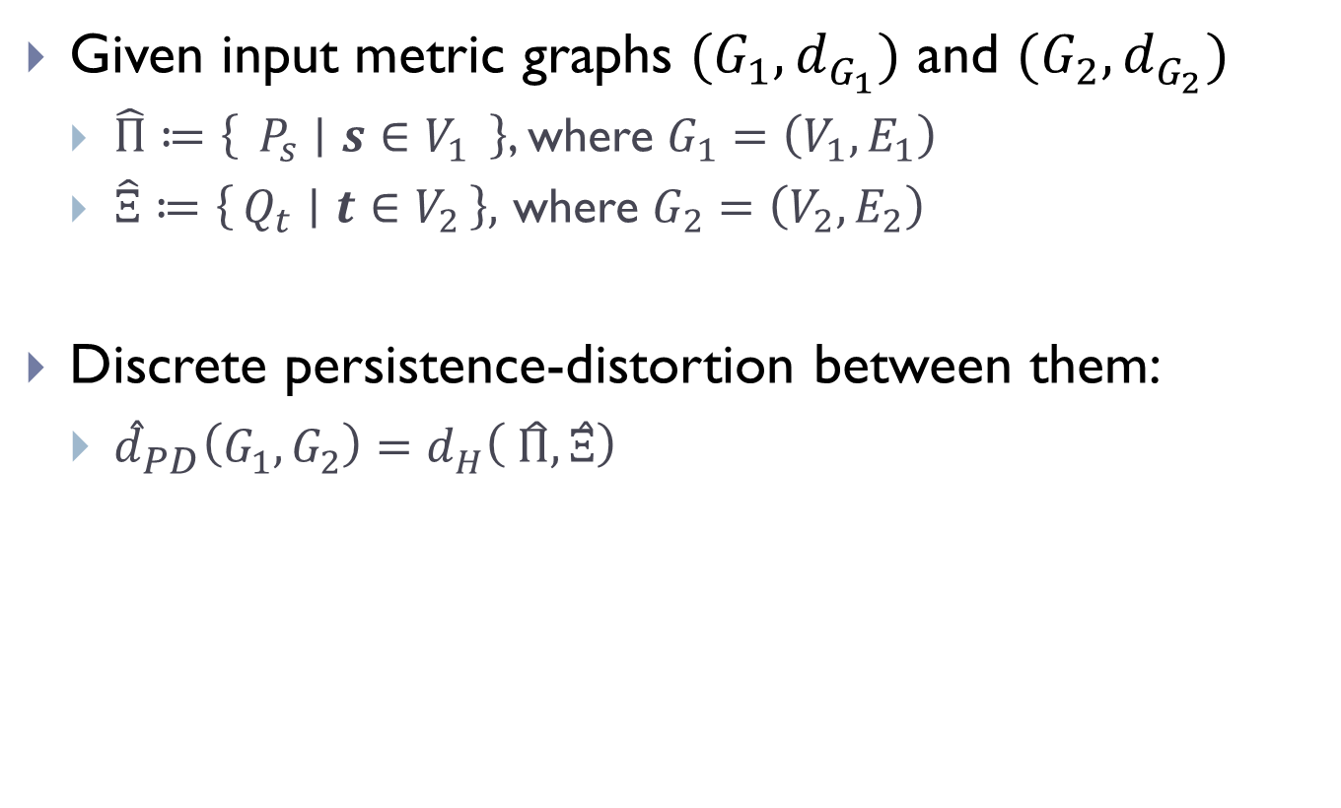
Discrete Case
Given input metric graphs $(G_{1},d_{G_{1}})$ and $(G_{2},d_{G_{2}})$
  $\hat{Π}≔\left\{ P_{s} ∣ s∈V_{1} \right\}$, where $G_{1}=\left(V_{1},E_{1}\right)$
  $\hat{Ξ}≔\left\{Q_{t} ∣ t∈V_{2}\right\},$ where $G_{2}=\left(V_{2},E_{2}\right)$
Discrete persistence-distortion between them:
  ${\hat{d}}_{PD}\left(G_{1},G_{2}\right)=d_{H}\left( \hat{Π}, \hat{Ξ}\right)$

Slide 26
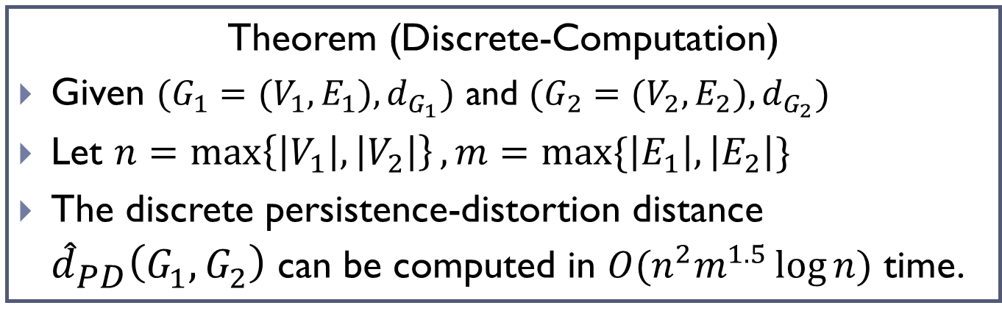
Theorem (Discrete-Computation)
Given $(G_{1}=(V_{1},E_{1}),d_{G_{1}})$ and $(G_{2}=(V_{2},E_{2}),d_{G_{2}})$
Let $n=\max\left\{\left|V_{1}\right|, \left|V_{2}\right|\right\}, m=max⁡\{\left|E_{1}\right|, \left|E_{2}\right|\}$
The discrete persistence-distortion distance ${\hat{d}}_{PD}\left(G_{1},G_{2}\right)$ can be computed in $O(n^{2}m^{1.5}\log{n)}$ time.

Slide 27
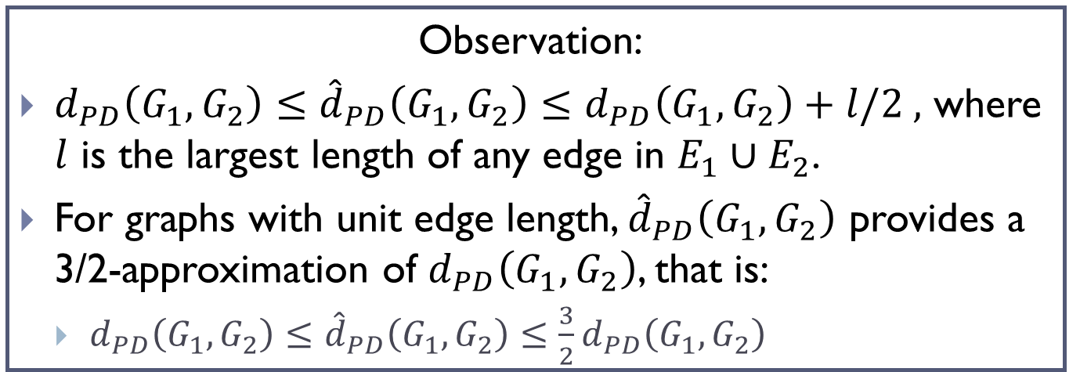

Observation:
$d_{PD}\left(G_{1},G_{2}\right)≤{\hat{d}}_{PD}\left(G_{1},G_{2}\right)≤d_{PD}\left(G_{1},G_{2}\right)+l/2 ,$ where $l$ is the largest length of any edge in $E_{1}∪E_{2}$.
For graphs with unit edge length, ${\hat{d}}_{PD}\left(G_{1},G_{2}\right)$ provides a 3/2-approximation of $d_{PD}\left(G_{1},G_{2}\right)$, that is:
  $d_{PD}\left(G_{1},G_{2}\right)≤{\hat{d}}_{PD}\left(G_{1},G_{2}\right)≤{\frac{3}{2}d}_{PD}\left(G_{1},G_{2}\right)$
In general, how to use ${\hat{d}}_{PD}\left(G_{1},G_{2}\right)$ to provide an approximation of $d_{PD}\left(G_{1},G_{2}\right)$ with multiplicative error?

Slide 28
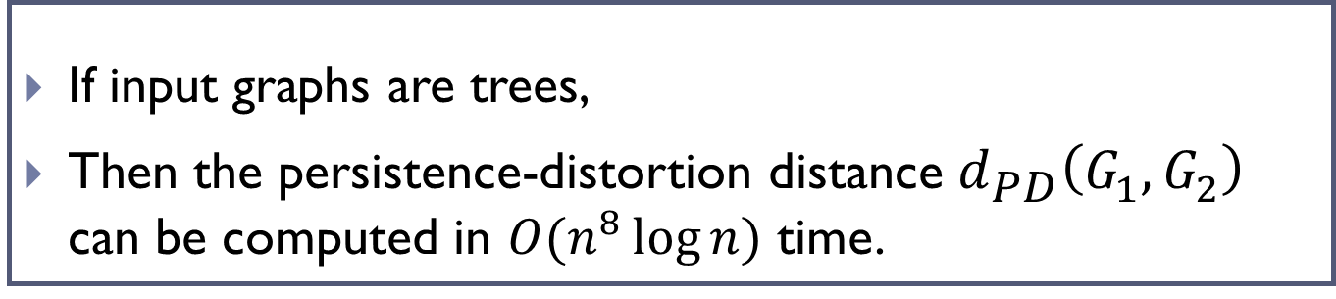
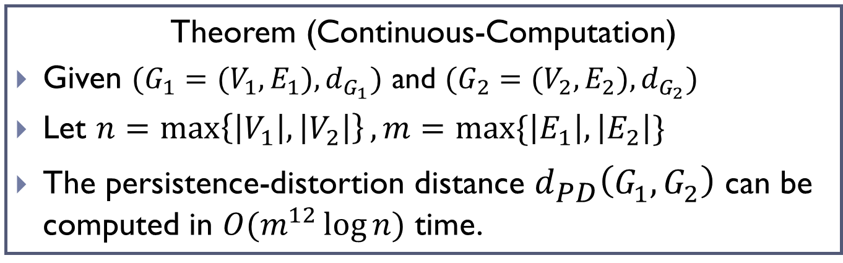
Theorem (Continuous-Computation)
Given $(G_{1}=(V_{1},E_{1}),d_{G_{1}})$ and $(G_{2}=(V_{2},E_{2}),d_{G_{2}})$
Let $n=\max\left\{\left|V_{1}\right|, \left|V_{2}\right|\right\}, m=max⁡\{\left|E_{1}\right|, \left|E_{2}\right|\}$
The persistence-distortion distance $d_{PD}\left(G_{1},G_{2}\right)$ can be computed in $O(m^{12}\log{n)}$ time.
If input graphs are trees,
Then the persistence-distortion distance $d_{PD}\left(G_{1},G_{2}\right)$ can be computed in $O(n^{8}\log{n)}$ time.

Slide 29


As basepoint $s$ moves, we have a time-varying function, and persistence-points trace out vines in a vineyard
  [Cohen-steiner, Edelsbrunner, Morozov, SoCG 2006]
$$σ=\left(v_{0},v_{1}\right)$$

Slide 30
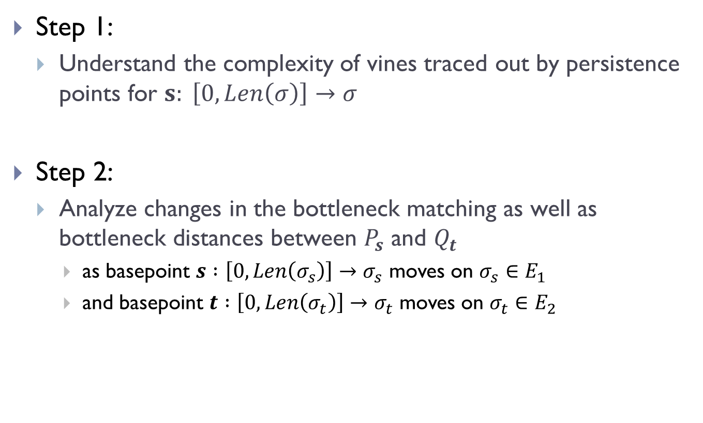
Sketch of Approach
Step 1:
  Understand the complexity of vines traced out by persistence points for $s: \left[0, Len\left(σ\right)\right]→σ$
Step 2:
  Analyze changes in the bottleneck matching as well as bottleneck distances between $P_{s}$ and $Q_{t}$
    as basepoint $s :\left[0, Len\left(σ_{s}\right)\right]→σ_{s}$ moves on $σ_{s}∈E_{1}$
    and basepoint $t :\left[0, Len\left(σ_{t}\right)\right]→σ_{t}$ moves on $σ_{t}∈E_{2}$

Slide 31
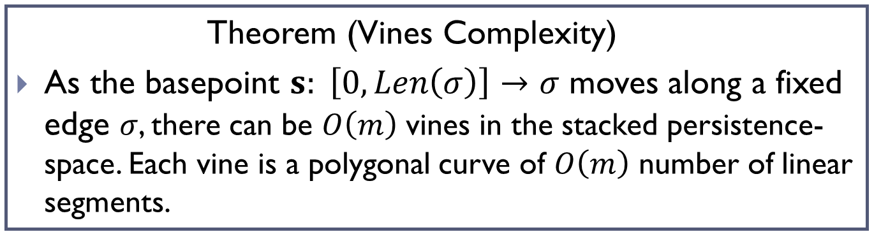
Step 1
Theorem (Vines Complexity)
As the basepoint $s: \left[0, Len\left(σ\right)\right]→σ$ moves along a fixed edge $σ$, there can be $O\left(m\right)$ vines in the stacked persistence-space. Each vine is a polygonal curve of $O\left(m\right)$ number of linear segments.

Slide 32

Step 2: Changes in bottleneck matching
Red points:
  Pers-points in persistence diagram $P_{s}$ for basepoint $s∈σ_{s}∈E_{1}$
Blue points:
  Pers-points in persistence diagram $Q_{t}$ for basepoint $t∈σ_{t}∈E_{2}$

Slide 33
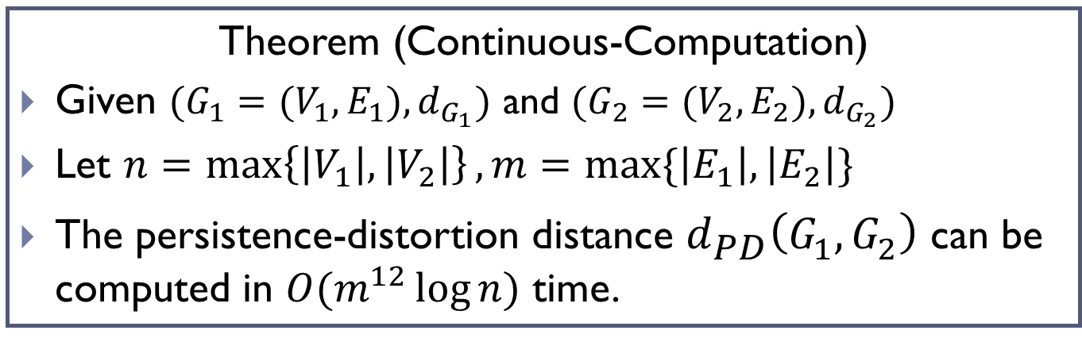
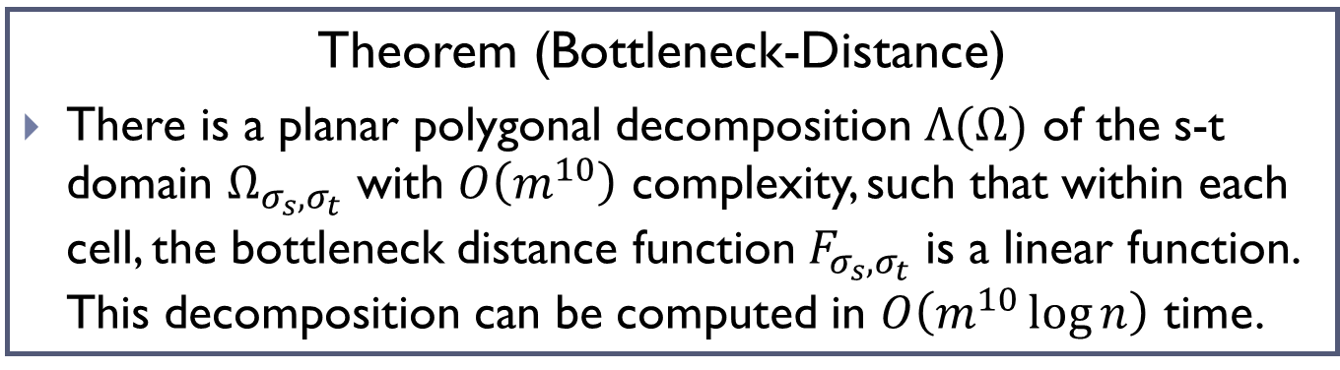
Theorem (Bottleneck-Distance)
There is a planar polygonal decomposition $Λ(Ω)$ of the s-t domain $Ω_{σ_{s}, σ_{t}}$ with $O\left(m^{10}\right)$ complexity, such that within each cell, the bottleneck distance function $F_{σ_{s}, σ_{t}}$ is a linear function. This decomposition can be computed in $O\left(m^{10}\log{n}\right)$ time.
Theorem (Continuous-Computation)
Given $(G_{1}=(V_{1},E_{1}),d_{G_{1}})$ and $(G_{2}=(V_{2},E_{2}),d_{G_{2}})$
Let $n=\max\left\{\left|V_{1}\right|, \left|V_{2}\right|\right\}, m=max⁡\{\left|E_{1}\right|, \left|E_{2}\right|\}$
The persistence-distortion distance $d_{PD}\left(G_{1},G_{2}\right)$ can be computed in $O(m^{12}\log{n)}$ time.

Slide 34
Preliminary Exp (2)

Slide 35
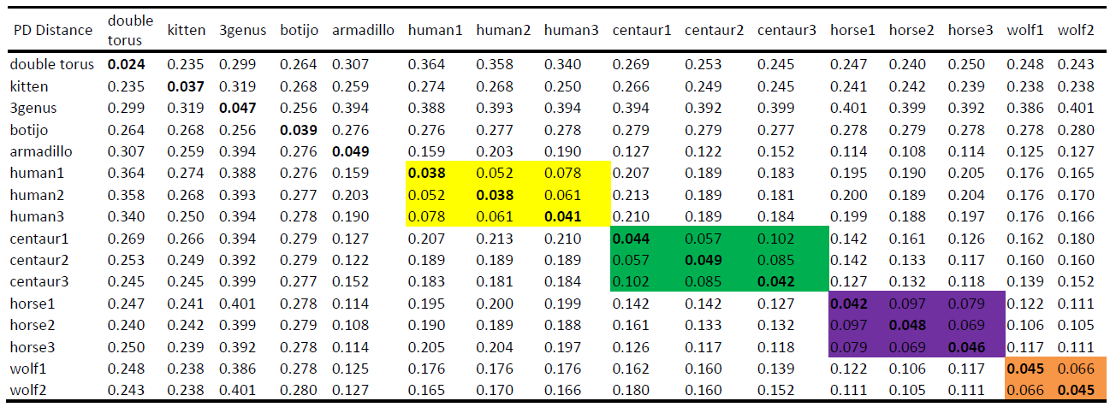
  pairwise persistence-distortion distance between models

Slide 36
This Talk
Some recent examples of analyzing / understanding graphs using topological ideas / algorithms
Metric graph matching
  via persistence distortion
Geometric graph reconstruction
  via discrete Morse theory
Understanding metric graphs
  of persistence signature induced by the intrinsic Cech filtration

Slide 37

Graph Reconstruction
Input:
  Certain samples of a hidden (geo)metric graph $G$
Goal:
  A reconstruction $\hat{G}$of the $G$
Reconstruction strategies and guarantees depend on the type of input data

Slide 38
Some Related Work
(Metric / geometric) graph reconstruction from point samples with bounded (Gromov-)Hausdorff error
  Local homology based:
    [Aanjaneya et al., SoCG 2011]
  Reeb graph (or variants) based:
    [Natali et al., Graphical Models 2011], [Ge et al. W. , NIPS 2011], [Chazal et al, DCG 2015]…
This talk: an effective graph reconstruction algorithm to handle ambient noise

Slide 39
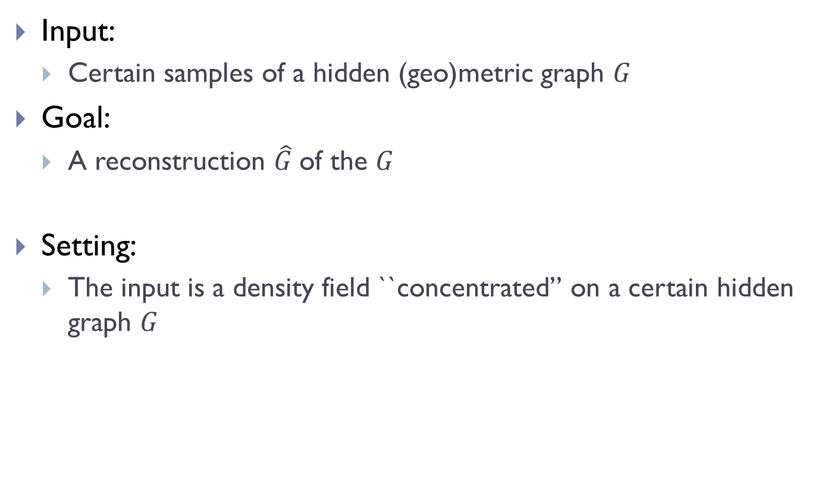
This Talk
Input:
  Certain samples of a hidden (geo)metric graph $G$
Goal:
  A reconstruction $\hat{G}$of the $G$
Setting:
  The input is a density field ``concentrated’’ on a certain hidden graph $G$

Slide 40

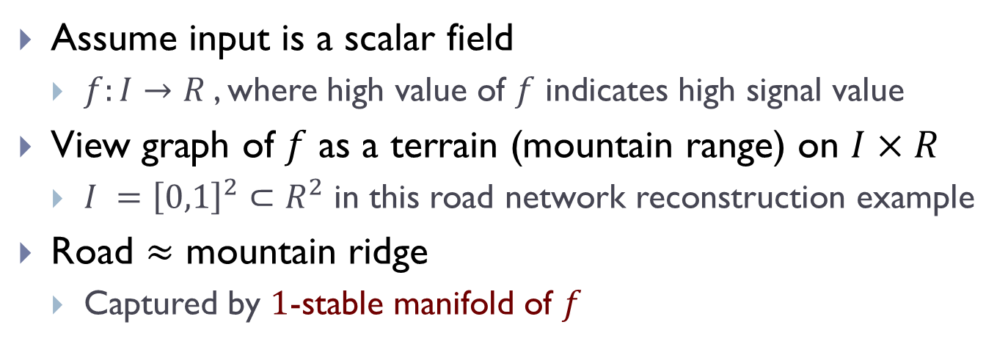
Main Idea
Assume input is a scalar field
  $f:I→R$, where high value of $f$ indicates high signal value
View graph of $f$ as a terrain (mountain range) on $I×R$
  $I ={\left[0,1\right]}^{2}⊂R^{2}$ in this road network reconstruction example
Road $≈$ mountain ridge
  Captured by $1$-stable manifold of $f$

Slide 41
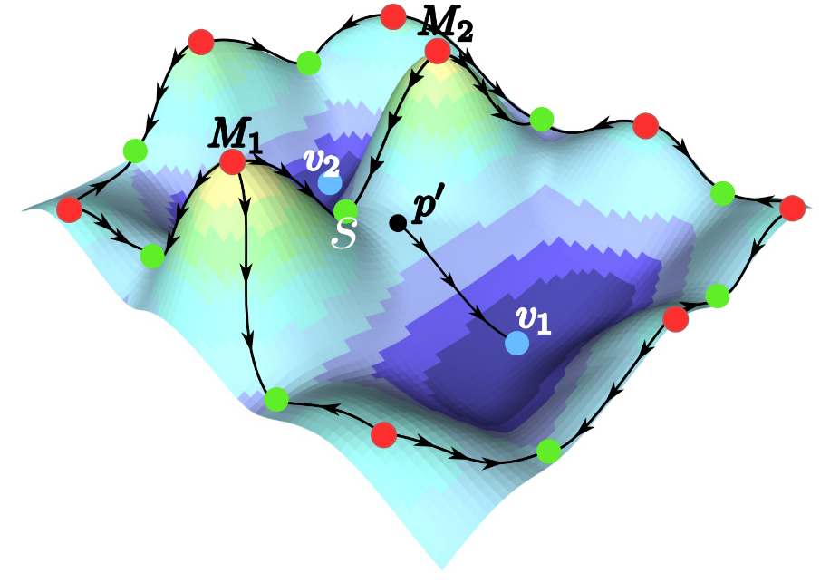
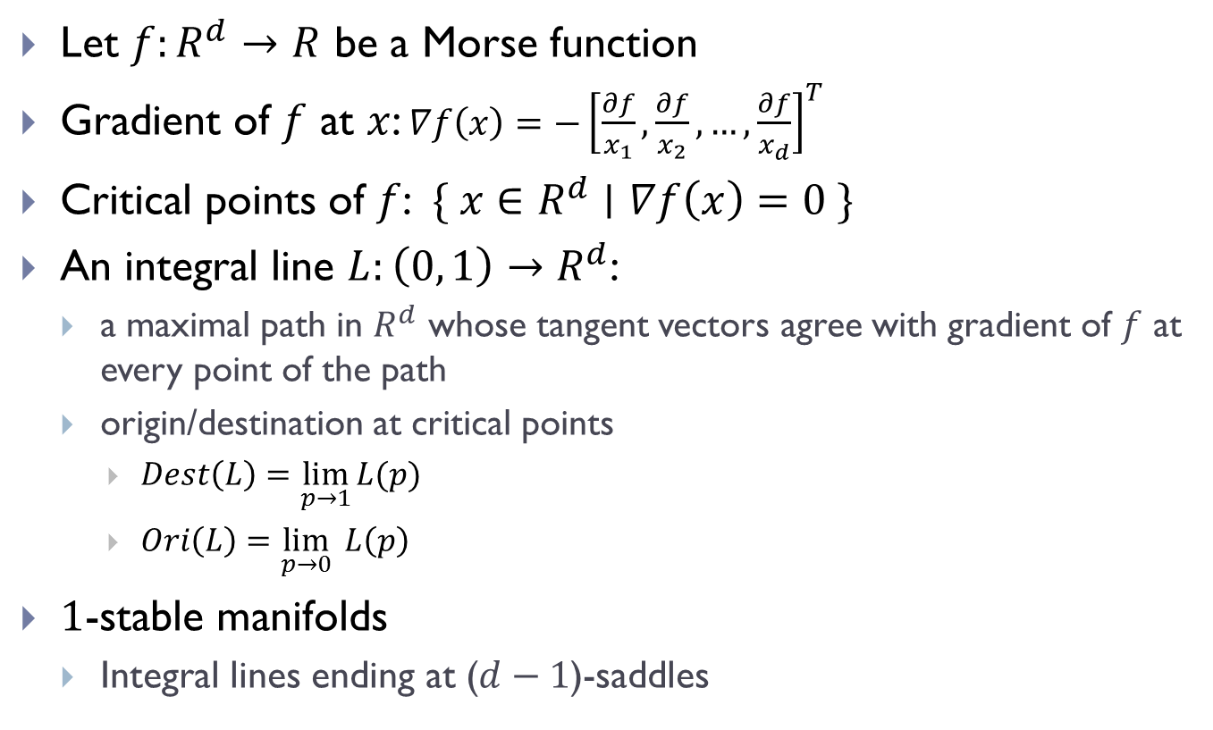

Morse Theory: Smooth Case
Let $f:R^{d}→R$ be a Morse function
Gradient of $f$ at $x$: $∇f\left(x\right)={−\left[\frac{∂f}{x_{1}},\frac{∂f}{x_{2}}, …,\frac{∂f}{x_{d}}\right]}^{T}$
Critical points of $f$: $\{ x∈R^{d}∣∇f\left(x\right)=0 \}$
An integral line $L:\left(0, 1\right)→R^{d}$:
  a maximal path in $R^{d}$ whose tangent vectors agree with gradient of $f$ at every point of the path
  origin/destination at critical points
    $Dest\left(L\right)=\lim_{p→1}{L(p)}$
    $Ori\left(L\right)=\lim_{p→0}{L\left(p\right) }$
$1$-stable manifolds
  Integral lines ending at ($d−1$)-saddles
$$x$$

Slide 42
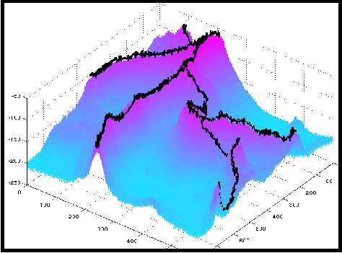
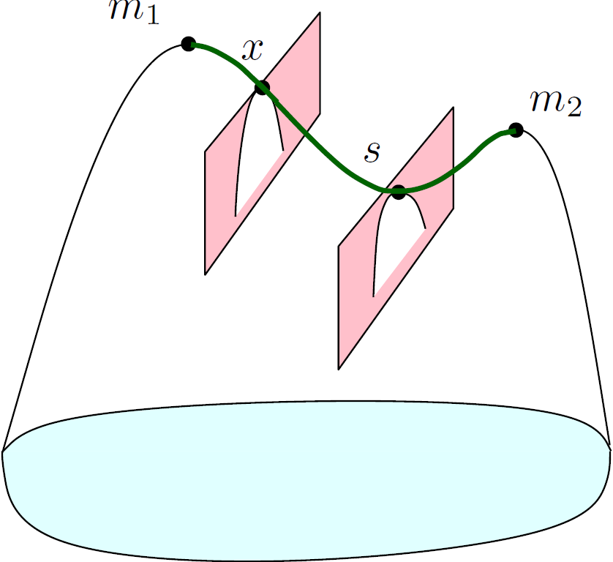
1-stable Manifold
$1$-stable manifold (of index $d−1$ saddle points) $≈$ mountain ridges

Slide 43
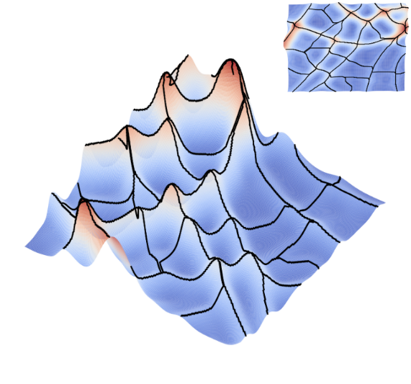
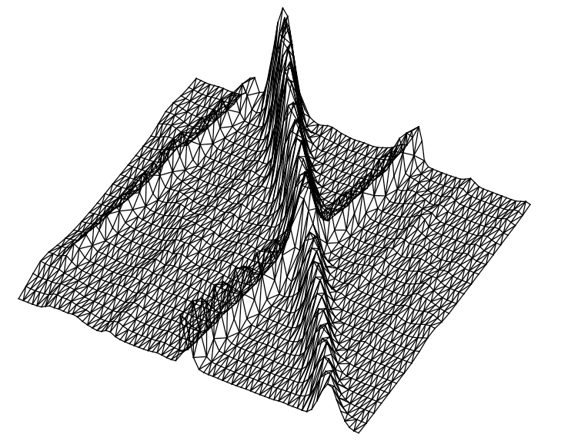

Discrete Case
Smooth case
  $1$-stable manifold from Morse theory
Discrete case
  Piecewise-linear (PL) approximation?

Slide 44
Discrete Morse Theory
[Forman 1998, 2002]
Combinatorial version of Morse theory
Many results analogous to classical Morse theory
Works for cell complexes
Combinatorial, thus numerically stable
Algorithmically often easy to handle, especially simplification

Slide 45
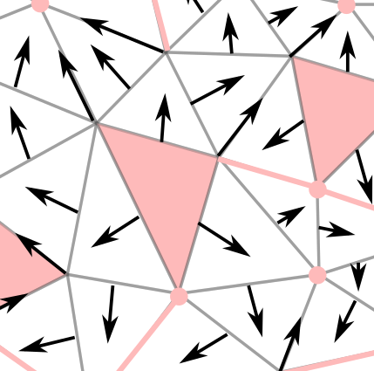
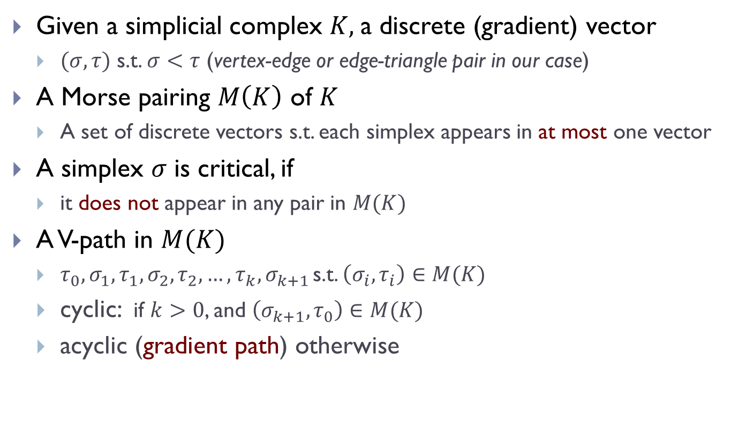
Discrete Gradient Vector Field
Given a simplicial complex $K,$a discrete (gradient) vector
  $(σ, τ)$ s.t. $σ<τ$ (vertex-edge or edge-triangle pair in our case)
A Morse pairing $M\left(K\right)$ of $K$
  A set of discrete vectors s.t. each simplex appears in at most one vector
A simplex $σ$ is critical, if
  it does not appear in any pair in $M(K)$
A V-path in $M(K)$
  $τ_{0},σ_{1},τ_{1},σ_{2},τ_{2},…, τ_{k},σ_{k+1 }$s.t. $\left(σ_{i}, τ_{i}\right)∈M(K)$
  cyclic: if $k>0$, and $\left(σ_{k+1}, τ_{0}\right)∈M(K)$
  acyclic (gradient path) otherwise

Slide 46
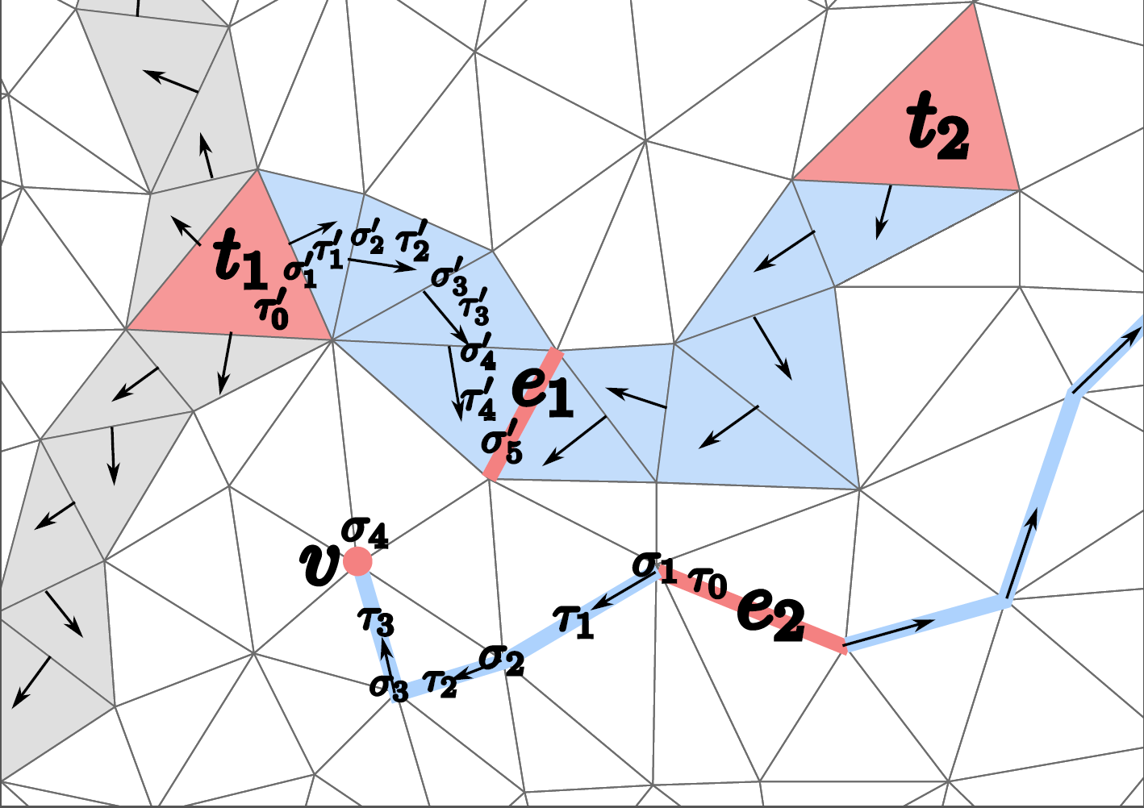
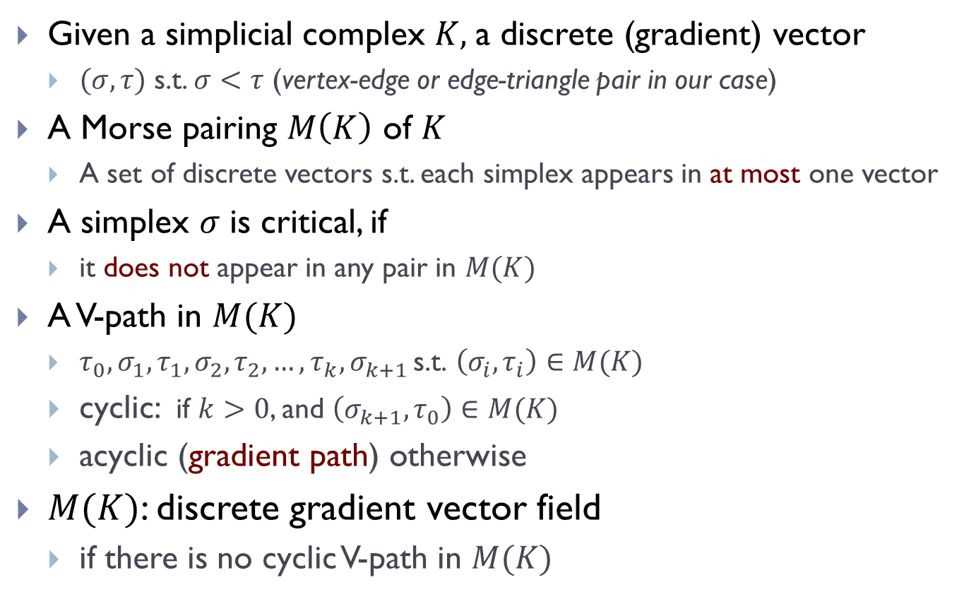
Discrete Gradient Vector Field
Given a simplicial complex $K,$a discrete (gradient) vector
  $(σ, τ)$ s.t. $σ<τ$ (vertex-edge or edge-triangle pair in our case)
A Morse pairing $M\left(K\right)$ of $K$
  A set of discrete vectors s.t. each simplex appears in at most one vector
A simplex $σ$ is critical, if
  it does not appear in any pair in $M(K)$
A V-path in $M(K)$
  $τ_{0},σ_{1},τ_{1},σ_{2},τ_{2},…, τ_{k},σ_{k+1 }\text{s}\text{.}\text{t}\text{. }\left(σ_{i}, τ_{i}\right)∈M(K)$
  cyclic: if $k>0$, and $\left(σ_{k+1}, τ_{0}\right)∈M(K)$
  acyclic (gradient path) otherwise
$M(K)$: discrete gradient vector field
  if there is no cyclic V-path in $M(K)$

Slide 47

Discrete Gradient Vector Field
Discrete Morse function discrete gradient vector field
A discrete Gradient Vector field $≈$gradient field for Morse functions
  critical $k$-simplex $≈$ index-$k$ critical point
  critical edge $≈$ saddles for function on $R^{2}$
  $1$-stable manifolds: edge-triangle V-paths
  $1$-unstable manifolds: vertex-edge V-paths (``valley ridges’’)

Slide 48
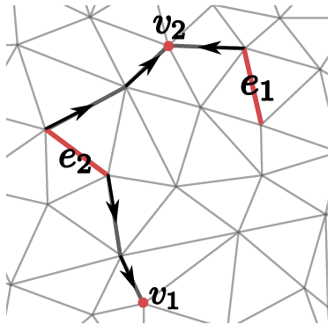
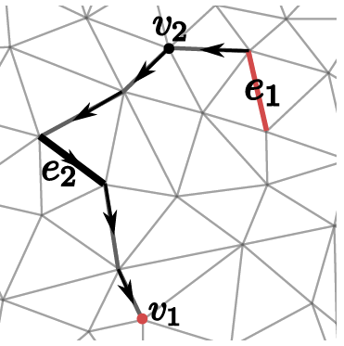
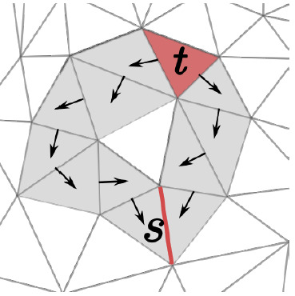



Simplification via Morse Cancellation
Morse cancellation operation (to simplify the vector field):
  A pair of critical simplices $〈σ, τ〉$ can be cancelled
    if there is a unique gradient path between them
    By reverting that gradient path
canceling $〈v_{2},e_{2}〉$
$〈s,t〉$not cancellable

Slide 49

Morse cancellation of critical pairs simplify the discrete gradient vector fields
  which further simplifies $1$-(un)stable manifolds
But which critical pairs should we cancel?
  intuitively: less important ones corresponding to noise
Persistence homology induced by the density function to guide the cancellation of critical pairs
  ``persistence’’ capturing ``importance’’ of critical pairs
  [Edelsbrunner, Letscher, Zomorodian 2002], [Zomorodian, Carlsson 2005], …

Slide 50









Sublevel-set Persistence – Simplified view
Input: $f:R→R$
$$f$$
Induced persistence pairings $P\left(f\right)$
  $〈x_{3},x_{4}〉, pers=f\left(x_{4}\right)−f\left(x_{3}\right)$
  $〈x_{2},x_{5}〉$, $〈x_{1},x_{6}〉$, …
$$x_{5}$$
$$x_{4}$$
$$x_{3}$$
$$x_{2}$$
$$a_{1}^{+}$$
$$x_{1}$$

Slide 51

Discrete Case
A piecewise-linear (PL) function $ρ:\left|K\right|→R$ defined on a simplicial complex domain $K$
Persistence algorithm via lower-star filtration
  [Edelsbrunner, Letscher, Zomorodian 2002],
  A collection of persistence pairings:
  $P_{ρ}\left(K\right)=\{ \left(σ, τ\right)\}$, where $k=\dim\left(σ\right)=\dim\left(τ\right)−1$
    $σ:$creator, creating $k$-th homological features
    $τ:$ destroyer, killing feature created at $σ$
    $per\left(σ,τ\right)=ρ\left(τ\right)−ρ(σ)$: life time of this feature
Intuitively, pairs of simplices with positive persistence corresponding to persistence pairing of critical points in the smooth case.

Slide 52

Main Algorithm
Input:
  Triangulation $K$of domain $I⊂R^{d}$, function $f:K→R$, threshold $δ$
  Initialize discrete gradient vector field $W$ on $K$ to be the trivial one
Step 1: persistence computation
  Compute persistence pairings $P(K)$ induced by function $−f$
Step 2: Morse simplification
  Simplify $W$ by performing Morse cancellation for all critical pairs from $P(K)$ with persistence $≤δ$, if possible
Step 3: collect output
  For all remaining critical edges with persistence $>δ$
  collect their $1$-unstable manifolds and output
[Gyulassy, PhD thesis 2008], [Robins et al. 2011], [Delgado-Friedrichs et al 2015], [Sousbie, 2015], [Wang, Li, W., 2015]

Slide 53

An application: road network reconstruction
[Wang, Li, W., 2015]
Athens
Beijing
Berlin

Slide 54


Effect of Simplification
Berlin, 27189 trajectories

Slide 55




Thresholding?
increasing threshold

Slide 56

Application: neuron reconstruction
DIADAM dataset OP 2

Slide 57
Further simplification of the algorithm/editing strategy
Reconstruction guarantees under a (simple) noise model
  [Dey, Wang, W, 2017], [Dey, Wang, W., 2018]

Slide 58
Main Algorithm
Input:
  Triangulation $K$of domain $I⊂R^{d}$, function $f:K→R$, threshold $δ$
  Initialize discrete gradient vector field $W$ on $K$
Step $1$: persistence computation
  Compute persistence pairings $P(K)$ induced by function $−f$
Step $2$: Morse simplification
  Simplify $W$ by performing Morse cancellation for all critical pairs from $P(K)$ with persistence $≤δ$, if possible
Step $3$: collect output
  For all remaining critical edges with persistence $>δ$
  collect their $1$-unstable manifolds and output

Slide 59

Simplified Algorithms
Step $2$ (Morse simplification) is replaced by
  No need to cancel edge-triangle critical pair
  No need to check whether cancellation is valid or not
  No explicit cancellation operation is needed !
    simply collect all ``negative’’ edges whose persistence is at most $δ$
Simplified Step 2:
Linear time to collect a set of edges, and they form a spanning forest that contain all necessary information of discrete gradient field

Slide 60

Simplified Algorithm – cont.
Step $3$ (collecting output) is replaced by:
  No explicit discrete gradient vector field maintained!
  Simplified algorithm even easier and faster
    [Attali et al 2009], [Bauer et al 2012]
Theorem
Time complexity of the simplified algorithms is $O\left(n+Time\left(Per\right)\right)$ where $n$is the total number of vertices and edges in $K$.
This holds for any dimensions.

Slide 61





Noise Model
True graph $G⊂Ω≔{\left[0, 1\right]}^{d}$
$G^{ω}⊂Ω$: an $ω$-neighborhood of $G$
  such that for (i) any $x∈G^{ω}$, $d\left(x, G\right)≤ω$; and (ii) $G^{ω}$deformation retracts to $G$
A function $ρ:Ω→R$ is ($β,μ, ω)$-approximation of $G$
  if there exists an $ω$-neighborhood $G^{ω}$of $G$so that
    $ρ\left(x\right)∈[β, β+μ]$, for any $x∈G^{ω}$
    $ρ\left(x\right)∈\left[0, μ\right]$, otherwise
    $β>2μ$

Slide 62

Noise Model
True graph $G⊂Ω≔{\left[0, 1\right]}^{d}$
$G^{ω}⊂Ω$: an $ω$-neighborhood of $G$
  such that for (i) any $x∈G^{ω}$, $d\left(x, G\right)≤ω$; and (ii) $G^{ω}$deformation retracts to $G$
A function $ρ:Ω→R$ is ($β,μ, ω)$-approximation of $G$
  if there exists an $ω$-neighborhood $G^{ω}$of $G$so that
    $ρ\left(x\right)∈[β, β+μ]$, for any $x∈G^{ω}$
    $ρ\left(x\right)∈\left[0, μ\right]$, otherwise
    $β>2μ$
In discrete case,
  $K$a triangulation of $Ω$, $G^{ω}⊂K$, $ρ$ defined at vertices of $K$

Slide 63



Main Results
Theorem (Geometry)
For any dimension $d,$under our noise model and for appropriate $δ$, the output graph $\hat{G}$satisfies $\hat{G}⊂G^{ω}$.
Theorem (Topology)
For any dimension $d,$under our noise model and for appropriate $δ$, the output graph $\hat{G}$is homotopy equivalent to $G$.
Theorem (Topology in 2D)
For $d=2,$under our noise model and for appropriate $δ$, there is a deformation retraction from $G^{ω}$ to $\hat{G}$.

Slide 64
This Talk
Some recent examples of analyzing / understanding graphs using topological ideas / algorithms
Metric graph matching
  via persistence distortion
Geometric graph reconstruction
  via discrete Morse theory
Understanding metric graphs
  of persistence signature induced by the intrinsic Cech filtration

Slide 65

Problem Introduction
General goal:
  Provide qualitative understanding of persistence summaries for graphs
Consider the following natural persistence summary
  Assume the input is a metric graph $(G, d_{G})$
  Persistent homology induced by the intrinsic Cech filtration of $(G, d_{G})$
    Resulting persistence diagram: $Dg_{∗}IC_{G}$
Čech filtration: $C^{α_{0}}\left(G\right)⊆C^{α_{1}}(G)⊆⋯C^{α}(G)⊆⋯$
Persistence module: $H_{∗}{(C}^{α_{0}})→{H_{∗}(C}^{α_{1}})→⋯{H_{∗}(C}^{α})⋯$

Slide 66

For an $n$-cycle
At a fixed scale
  [Adamaszek, Adams, Frick, Peterson, Previte-Johnson, 2016]
  [Adamaszek and Adams, 2017] for Vietories-Rips complex
Theorem [Adamaszek et al. 2016]
The nerve complex and the clique complex of any finite collection of arcs in the circle are homotopy equivalent to either a point, an odd-dimensional sphere, or a wedge sum of spheres of the same even dimension.

Slide 67

1-Dimensional case
[Gasparovic, Gommel, Purvine, Sazdanovic, Wang, W., and Ziegelmeier, 2017]

Slide 68

High dimensional case
Recent understanding of the Rips complex for special family of graphs
  which can be obtained by metric gluing of cycles
  [Adamaszek, Adams, Gasparovic, Gommel, Purvine, Sazdanovic, Wang, W., and Ziegelmeier, 2017]

Slide 69

High dimensional case
Recent understanding of the Rips complex for special family of graphs
  which can be obtained by metric gluing of cycles
  [Adamaszek, Adams, Gasparovic, Gommel, Purvine, Sazdanovic, Wang, W., and Ziegelmeier, 2017]

Slide 70
Concluding Remarks
Show how topological/geometric ideas can be used
  Many open problems remain for each individual directions
    Efficient algorithms
    Topological-based matching for geometric (embedded) graphs
    …
Qualitative studies of topological methods
  Persistence homology transfer
    Map a shape / an object to a certain persistence diagram or a collection of persistence diagrams
    Precisely what information can it capture?
More general perturbation / noise model
  Random, non-Hausdorff or non-Gromov-Hausdorff error

